Slide 1

SPRING MVC & SPRING AOP
BLESSON JOHN ABRAHAM (245045)
ANIRUDH G (245099)
JENSON MATHEW (245048)
AMRUTHA M NAIR (245138)

Slide 2
Spring aop

Slide 3
WhAT IS SPRING AOP
Spring AOP (Aspect-Oriented Programming) is a programming paradigm that allows developers to modularize cross-cutting concerns in software applications.
Aspect-oriented programming (AOP) is a programming paradigm that focuses on the separation of concerns in software development.
In Spring AOP, an aspect is a modular unit of behavior that can be applied to multiple classes and methods.

Slide 4
AOP ARCHITECTURE
Spring AOP uses proxy-based architecture to apply aspects to target objects.
The proxy is an object that stands in for the target object and intercepts method calls to apply advice.
The target object is the object being advised, and it is not aware of the advice applied to it.
The advice is the code that is executed at join points to provide cross-cutting behavior.
The join point is a specific point in the program execution where advice can be applied, such as method invocations or field accesses.

Slide 5
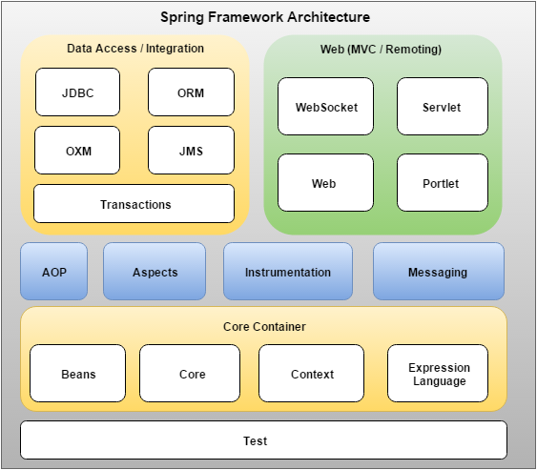
Spring aop architecture

Slide 6
AOP Terminologies:
Aspect:
An aspect represents a class that contains advices, join points etc like transaction management. An aspect can be configured through Spring XML configuration or spring AspectJ integration.
Join point:
Joint point represents a point in our application where we can plug-in AOP aspect. It can be method execution, exception handling, field access etc. Spring AOP only supports method execution joint type.

Slide 7
AOP TERMINOLOGIES:
Advice:
It represents the actual action to be taken by an aspect at a particular join point. In programming point view.
Pointcut
It represents the expression which is matched with join points to determine whether advice to be executed or not.

Slide 8
AOP TERMINOLOGIES:
.
Introduction
It provides the facility to add new methods or attributes to existing classes.
Target object
It is an object on which advices are applied. It always be proxied object in spring because Spring AOP is implemented using runtime proxies.

Slide 9
AOP Advice Types
Before
It executes before the method execution.
After
It executes after the method execution. It not depends upon the method outcome.
after-returning
It executes after the method execution when method completes successfully.

Slide 10
AOP ADVICE TYPES
after-throwing
It executes after the method execution when method exits by throwing an exception.
Around
It executes before and after the advised method is called.

Slide 11
SPRING AOP CONFIGURATION
Define your aspect: An aspect is a modularization of a cross-cutting concern, such as logging or transaction management.
Define your pointcut: A pointcut defines the set of join points where an aspect should be applied.
Define your advice: An advice is the code that runs when a join point is reached.
Configure your aspects: You need to configure your aspects to specify the pointcuts and advice to use.

Slide 12
APPLICATIONS OF SPRING AOP
Logging: One of the most common use cases of AOP is logging, where you can add logging statements to your code without cluttering it.
Security: Spring AOP can be used to implement security aspects in an application. For example, you can add security checks to certain methods or classes, such as checking if a user is authenticated before allowing access to a resource.
Transaction management: Spring AOP can be used to implement declarative transaction management, where you can define transactions using annotations or XML configuration.

Slide 13
APPLICATIONS OF SPRING AOP
Performance monitoring: Spring AOP can be used to monitor the performance of your application. You can add performance monitoring aspects to your code to track how long certain methods take to execute or how many times they are called.
Caching: Spring AOP can be used to implement caching aspects in an application, where you can cache the results of certain methods to improve performance.

Slide 14
APPLICATIONS OF SPRING AOP
Exception handling: Spring AOP can be used to implement exception handling aspects in an application. For example, you can add exception handling aspects to your code to catch and handle specific types of exceptions, such as logging the error and notifying the appropriate stakeholders.

Slide 15
ADVANTAGES OF SPRING AOP
Code reusability: One of the primary advantages of using Spring AOP is code reusability. Aspects can be applied to multiple parts of your application without duplicating code, leading to more modular and maintainable code.
Separation of concerns: Spring AOP allows you to separate the concerns of your application.
Declarative programming: Spring AOP allows you to define aspects declaratively using XML, annotations, or Java-based configuration.

Slide 16
DISADVANTAGES OF SPRING AOP
Limited pointcut expressions: Spring AOP has limited pointcut expressions, which can make it difficult to target specific methods or classes.
Runtime overhead: Aspects in Spring AOP are woven at runtime, which can result in some runtime overhead.
Complexity of configuration: Spring AOP can be complex to configure, especially for more advanced scenarios.

Slide 17
SPRING MVP

Slide 18
What is Spring MVC?
A Spring MVC is a Java framework which is used to build web applications.
It follows the Model-View-Controller design pattern.
It implements all the basic features of a core spring framework like Inversion of Control, Dependency Injection.
A Spring MVC provides an elegant solution to use MVC in spring framework by the help of DispatcherServlet.
DispatcherServlet is a class that receives the incoming request and maps it to the right resource such as controllers, models, and views.

Slide 19
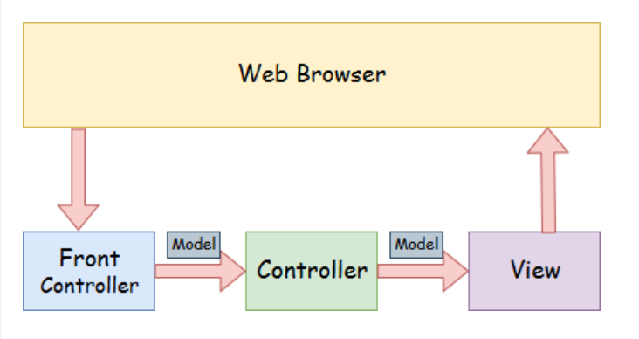
Spring MVC Architecture

Slide 20
Spring MVC Architecture
Model - A model contains the data of the application. A data can be a single object or a collection of objects.
Controller - A controller contains the business logic of an application. Here, the @Controller annotation is used to mark the class as the controller.
View - A view represents the provided information in a particular format. Generally, JSP+JSTL is used to create a view page. Although spring also supports other view technologies such as Apache Velocity, Thymeleaf and FreeMarker.
Front Controller - In Spring Web MVC, the DispatcherServlet class works as the front controller. It is responsible to manage the flow of the Spring MVC application.

Slide 21
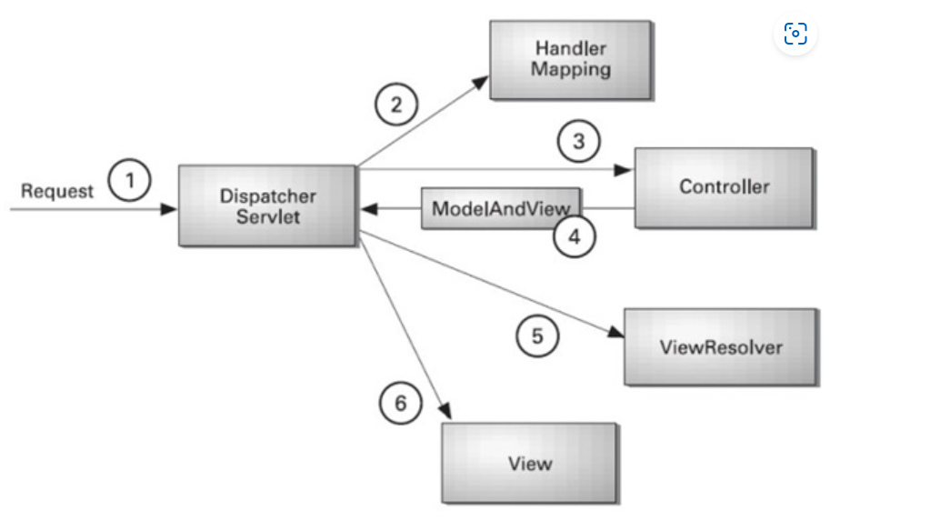
flow of Spring Web MVC

Slide 22
flow of Spring Web MVC
As displayed in the figure, all the incoming request is intercepted by the DispatcherServlet that works as the front controller.
The DispatcherServlet gets an entry of handler mapping from the XML file and forwards the request to the controller.
The controller returns an object of ModelAndView.
The DispatcherServlet checks the entry of view resolver in the XML file and invokes the specified view component.

Slide 23
Spring MVC Configuration
Create a Spring configuration file: You'll need to create a Spring configuration file (such as applicationContext.xml) to define the beans and other configuration settings for your application.
Configure the dispatcher servlet: The dispatcher servlet is the central component of Spring MVC that handles incoming requests and maps them to the appropriate controller.
Define your controller beans: Controllers are responsible for handling requests and returning responses.

Slide 24
SPRING MVC CONFIGURATION
Configure view resolvers: View resolvers are responsible for resolving view names to actual view templates .
Configure message converters: Message converters are responsible for converting between Java objects and HTTP requests and responses.
Set up resource handling: You'll need to configure your application to handle static resources (such as CSS, JavaScript, and images) by mapping the resource URLs to the appropriate files.

Slide 25
SECURITY IN SPRING MVC APPLICATION
Authentication: Spring Security can be used to handle authentication, which is the process of verifying a user's identity.
Authorization: Once a user has been authenticated, Spring Security can be used to handle authorization, which is the process of determining what a user is allowed to do.
Access Control: Spring Security can be used to restrict access to certain parts of a Spring MVC application.

Slide 26
SECURITY IN SPRING MVC APPLICATION
Cross-Site Request Forgery (CSRF) protection: Spring Security can be used to protect against CSRF attacks, which are a common form of web application attack.
Session Management: Spring Security can be used to manage user sessions, including handling session timeouts and invalidating sessions.

Slide 27
Advantages of Spring MVC Framework
Separate roles
Light-weight
Light-weight
Rapid development
Reusable business code
Easy to test
Flexible Mapping

Slide 28
Disadvantages of Spring MVC Framework
Steep Learning Curve
XML Configuration:
Boilerplate Code
Performance Overhead
Complex Configuration
Limited Support for Reactive Programming

Slide 29
Application OF SPRING MVC
Building RESTful web services: Spring MVC provides robust support for building RESTful web services, including features such as content negotiation, HTTP message conversion, and exception handling.
Developing web applications: Spring MVC provides a powerful model-view-controller (MVC) architecture for building web applications. It supports a wide range of view technologies, including JSP, Thymeleaf, and Mustache, and provides powerful data binding and validation capabilities.

Slide 30
application
Integrating with other Spring components: Spring MVC integrates seamlessly with other Spring components, such as Spring Data, Spring Security, and Spring Boot, making it easy to build complex web applications with minimal boilerplate code.
Testing web applications: Spring MVC provides a comprehensive testing framework that makes it easy to test web applications using popular testing frameworks like JUnit and Mockito.
Developing single-page applications: Spring MVC can be used in conjunction with popular JavaScript frameworks like Angular, React, and Vue.js to build powerful single-page applications.

Slide 31
THANK you

